Slide 1




Libreboot project
Free BIOS/UEFI replacement for x86/ARM.
The *original* coreboot distro! → https://libreboot.org/
Presentation by Leah Rowe (project founder, lead dev).
← and a little bit of this

Slide 2
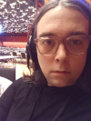
Who/what/when/why/where am I?
←Libreboot founder & lead dev since 2013.
←Canoeboot founder, 2023 (more later!)
Linux user since 2005. I like to tinker. me at 39c3→
Political background. Digital/human rights, environment. Free software activist since 2005.
I want freedom. I need you to also have it.
I sell Libreboot, and Libreboot accessories → https://minifree.org/

Slide 3

Structure of this talk
20-25 minutes of lecture (history, abstract, goals)
Not too much technical detail: just overviews, and then:
20 minutes of demo, plus Q & A
  Show how lbmk works, how to use it
  Audience can ask questions during the demo
  Perhaps ask me to show features / workflow / etc
5-10 minutes at the end: wrap-up, final q&a
Assuming I stick to this schedule (!)
These slides are released under Creative Commons Zero (CC-0)

Slide 4
What is Libreboot?
Free/OpenSource firmware, replace BIOS/UEFI
Initialise CPU, memory, peripherals, start your OS
Coreboot distro, just as Debian is a Linux distro
Linux and BSD operating systems well-supported.
Modular. Configurable. Automated builds.
For non-technical users - *and* power users.

Slide 5

Why use ?
The Four Freedoms are **absolute**
More secure. Lots of nice cryptography (GRUB)
No DRM / anti-features. The hardware is yours.
Continued updates, even if OEMs say no
Libreboot makes coreboot easy and fun

Slide 6

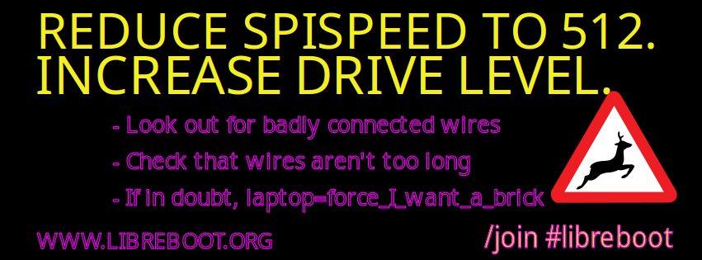
Goals of Libreboot
The Four Freedoms are **absolute**
User-friendly coreboot distribution
Support all of coreboot (and others)
Advanced boot securitye.g. strong encryption
Every computer in the world
Yes, even your ‚90s games console

Slide 7
Coreboot payloads
Coreboot only does basic hardware bringup
Jumps to payload. GRUB, Linux, edk2, etc.
Libreboot provides a selection of payloads.
Can use other payloads if you want.
Can run literally anything you want.
More info on https://coreboot.org/

Slide 8
LBMK (LibreBoot MaKe)
Source-based package manager.
Download/patch/compile sources
Eliminate manual build steps for coreboot
Libreboot users interact only with lbmk.
Similar to something like Debian apt-get.
A demo will be shown later!

Slide 9
How Libreboot started in 2013
I started a company selling coreboot (and coreboot accessories): https://minifree.org/
A friend told the Free Software Foundation (USA)
Free Software Foundation (USA) promoted it
Initially very simple (no build system / docs)
Libreboot.org registered early 2014
Started as an FSF-certified coreboot distro

Slide 10
Libreboot dev history 2013-2016
Initially started with ThinkPad X60 and MacBook2,1, later T60 and others.
Later expanded to more/newer ThinkPads e.g. X200, T400. ARM (RK3288) chromebooks.
2015-2016: desktop/server e.g. ASUS KGPE-D16
First automatic build system – very buggy back then! Very basic source-based package manager.
And a lot of releases. Many users! A lot of people helped → https://libreboot.org/contrib.html

Slide 11
A lot of Libreboot talks!
FOSDEM 2026 my first talk since 2018.
My previous Libreboot talks: Libreplanet 2015 (Cambridge, MA, USA), FSF30 (ditto), Open Source Days 2016 (Denmark), FOSDEM 2016 and 2017 (Bruxelles, Belgique), Freenode.Live 2018 (Bristol, UK)
I didn´t show up to my Libreplanet 2016 talk; FSF did the talk for me.

Slide 12
Libreboot *was* a GNU Project
The Four Freedoms are **absolute**
Applied for membership in 2015, granted in 2016.
Three GNU Libreboot releases in 2016
Technical disagreement: docs/design/governance
Ugly break-up in late 2016: Libreboot left GNU.
2017-2021: Apology. Lukewarm relations.

Slide 13
The Great Re-write, 2017-2021
2017-2021: I stepped down as leader. Put a committee in charge. Democratic governance: Sebastien Gryzywana, Andrew Robbins, Paul Kocialkowski.
Alyssa Rosenzweig helped establish the committee, in 2017.
Wholesale re-write of Libreboot, started by paulk. Greater configurability. Old Libreboot scrapped.
Project stalled for years. Code too complicated.
Lots of great work/people. I wasn’t involved.

Slide 14

OSBoot, 2020-2022
https://osboot.org/ (no longer exists)
I forked Libreboot (from 2016) in December 2020, into osboot. ← more on why 2016, next
More pragmatic: allowed binary blobs, under strictly limited circumstances (more board support)
Project started December 2020.
Merged with Libreboot in November 2022.
Caleb la Grange helped.

Slide 15
Binary Blob Reduction Policy
If a blob can be avoided, avoid it.
If it’s necessary, include it.
Try to isolate/sandbox it if possible.
E.g. me_cleaner used on Intel ME
Do without, in some cases (e.g. Intel GPUs)
https://libreboot.org/news/policy.html

Slide 16
March 2021 Libreboot takeover
I regarded the re-write as a failure.
I forked Libreboot from late 2016.
I (Leah Rowe) took over again!
I modernised the old Libreboot. New boards.
I removed the committee. Became BDFL again. Did own release: Libreboot 20210522.

Slide 17
2021: Lots of new infrastructure
Split up repos into build system, website, etc
Lots of new contribs. New boards. Bug fixes.
Aggressively attracted new devs
Project had been dead for years, so getting people onboard was hard.
It was rocky, but I revived the project.

Slide 18
OSBoot/Libreboot merge, 2022
We (Caleb and I) did it in a day!
Caleb la Grange merged the docs.
I did the build system (osbmk→lbmk)
I redirected osboot.org to libreboot.org
We did it all in a day. Lots of work after!
Post-merge Libreboot release, December 2022!

Slide 19
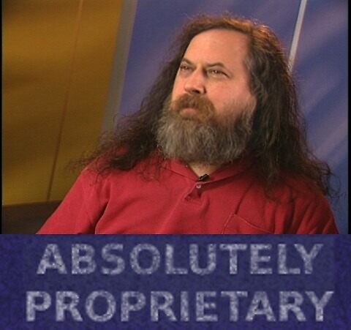
And the FSF was pissed.
Really pissed.
Can you guess what came next?

Slide 20
Hostile FSF-led fork of Libreboot
LibrePlanet 2023: Denis Carikli announces *libreboot.at* (domain) – a *hostile fork*.
FSF promoted it. They tried to *use the Libreboot name themselves*.
Their intention was clear: force me to stop using the Libreboot name.
I refused, instead declaring war on FSF

Slide 21
Hostile un-fork of Libreboot
I knew Denis would announce a fork at LP2023.
I did a release *hours* before his talk.
Libreboot.org then developed 5x as aggressively.
I asked Drew DeVault to delete the fork’s sr.ht account.
Drew complied. Fork went offline, and died.
I did another Libreboot (.org) release on the day their site went offline.
FSF became even more pissed.

Slide 22
FSF hostile fork, part 2
Libreboot.at re-branded to *GNU Boot*
Still based on old July 2022 Libreboot release
Slightly more respectful this time.
Using their own name. But their attitude hadn’t changed, and so…

Slide 23
Canoeboot project
I forked Libreboot into *Canoeboot* (late 2023)
Sounds similar to GNU Boot, but this is only a coincidence!
Canoeboot follows FSF policy perfectly.
Designed to compete aggressively with FSF.
Canoeboot is *years ahead* of GNU.
Lots of FSF people use Canoeboot quite heavily.
GNU cannot compete. Bureaucratic governance, slow to make changes.
Canoeboot has same problem as old Libreboot: inferior hardware support.

Slide 24

FSF and Libreboot ceasefire
Conflicted ended in 2025.
FSF executive director (Zoe) is the FSF’s best leader. Pragmatic, thoughtful, very intelligent.
FSF promotes Canoeboot now (campaigns page)
Libreboot and FSF relations cooled since 2025.
Libreboot free to do its own thing again

Slide 25
Lots of new work!
Libreboot now supports Intel 8th gen ThinkPads, since December 2024. Thanks to work done by Mate Kukri.
Work being done to add even newer, e.g. Alderlake
Work underway to support x86-64 Chromebooks (using MrChromebox)
Continued modernisation efforts e.g. edk2

Slide 26
Future roadmap
Massive documentation audit needed
Edk2 needed on desktops now (modern GPUs)
Integrate other coreboot distros / more boards
Attract board maintainers from upstream
Better ARM64 support. Support others e.g. LoongArch, RISC-V.
Integrate other firmware projects e.g. oreboot

Slide 27
Software in the Public Interest
Since late 2025, Libreboot is a member of SPI
https://www.spi-inc.org/projects/libreboot/
SPI provides fiscal infrastructure for projects.
They help lots of big projects like Debian.
They can help your project take donations.

Slide 28
!! Libreboot Hall of Fame !!
This page shows who contributed to Libreboot: https://libreboot.org/contrib.html
If you’re not on it, please contact Libreboot! It is #libreboot on the Libera IRC network. Stop by on IRC or just email me.
Lots of contributors. Too many to list in a talk (the talk would be 100 slides long).

Slide 29
How to help Libreboot
Use it. Tell people about it. I want you to use it!
Add new boards – and work on upstream e.g. coreboot.
Work on documentation.
Provide user support on IRC.

Slide 30
Licensing on images
RMS meme photo is fair use. Ditto the modified GNU logo (dank GNU). They were both for parody purposes.
Libreboot logo was by Marcus Moeller in 2014, under CC-0.
Canoeboot logo by Kuan Kraggs in 2023, under : Creative Commons Attribution-ShareAlike 4.0 International
Riku Viitanen made the rainbow version of the Libreboot logo, based on Marcus’s logo. Also CC-0.
I (Leah Rowe) made the „REDUCE SPISPEED“ meme. CC-0.

Slide 31
Thank you
Questions and answers will now begin.
A live demo will be performed showing lbmk.
Feel free to interject, ask for more demos, while there’s time. If you want to know how to do something perhaps?
Project is hosted here: https://libreboot.org/

